Slide 1
Used Cars Price Prediction
By Rakesh Chaudhary

Slide 2
Abstract
A car price prediction has been a high interest research area, as it requires noticeable effort and knowledge of the field expert. Considerable number of distinct attributes are examined for the reliable and accurate prediction.
The prices of new cars in the industry is fixed by the manufacturer with some additional costs incurred by the Government in the form of taxes. So, customers buying a new car can be assured of the money they invest to be worthy. But due to the increased price of new cars and the incapability of customers to buy new cars due to the lack of funds, used cars sales are on a global increase. There is a need for a used car price prediction system to effectively determine the worthiness of the car using a variety of features.
The focus of this project is developing machine learning models that can accurately predict the price of a used car based on its features, in order to make informed purchases. We implement and evaluate various learning methods on a dataset consisting of the sale prices of different makes and models across cities in India.

Slide 3
Introduction
Car price prediction is somehow interesting and popular problem.
Determining whether the listed price of a used car is a challenging task, due to the many factors that drive a used vehicle’s price on the market. The focus of this project is developing machine learning models that can accurately predict the price of a used car based on its features, in order to make informed purchases.
. We implement and evaluate various learning methods on a dataset consisting of the sale prices of different makes and models . We will compare the performance of various machine learning algorithms like Linear Regression, Ridge Regression, Lasso Regression, Decision Tree, Ensemble techniques and choose the best out of it.
Depending on various parameters we will determine the price of the car. Regression Algorithms are used because they provide us with continuous value as an output and not a categorized value because of which it will be possible to predict the actual price a car rather than the price range of a car.

Slide 4
Motivation for the Problem Undertaken
Deciding whether a used car is worth the posted price when you see listings online can be difficult. Several factors, including mileage, make, model, year, etc. can influence the actual worth of a car. From the perspective of a seller, it is also a dilemma to price a used car appropriately. Based on existing data, the aim is to use machine learning algorithms to develop models for predicting used car prices.

Slide 5
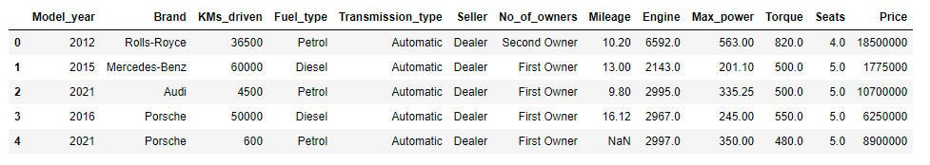
Sample Data Set:
Here:-
Unit of Mileage is Km/L
Unit of Torque is Nm (Newton Meter)
Unit of Engine is ‘CC’
Unit of Max_Power is BPH (brake horsepower)

Slide 6
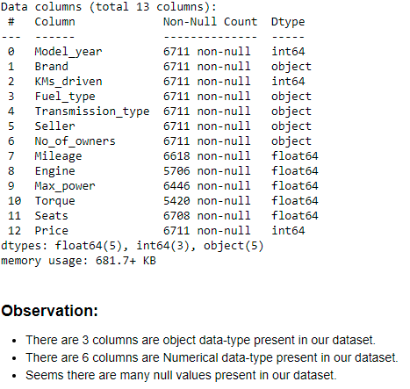
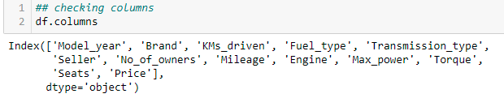
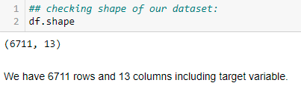

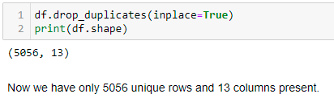
Basic Information of the Dataset

Slide 7
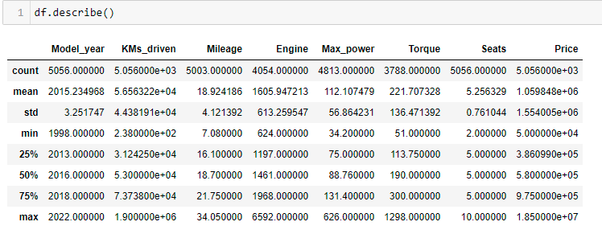
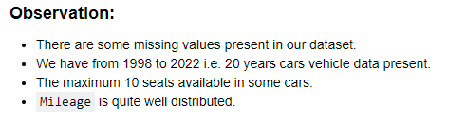
Statistical Summary

Slide 8
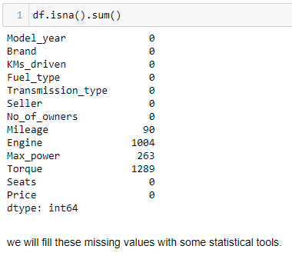
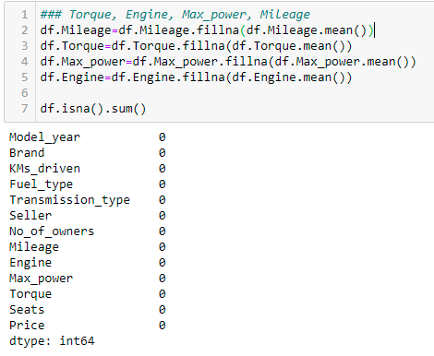
Checking Outliers
Handling Outliers

Slide 9
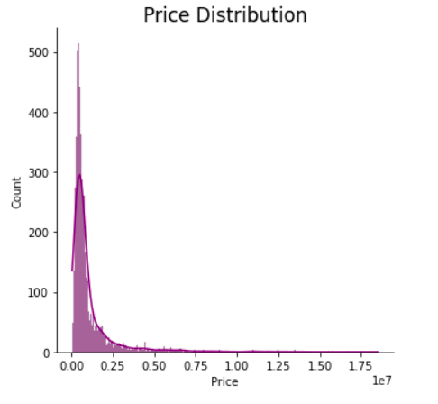
Visualization
Here we can see that our target variable is highly right skewed.
Most of data falling 2.5 , ie most of cars price are very cheap. This could be reason that why people want to buy used car except a buying a new car.

Slide 10
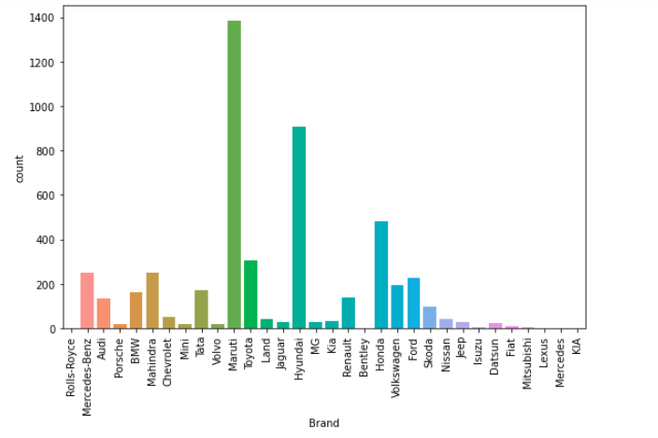
Brands of the Cars in Our dataset
We all know that Maruti capture huge market with respect of Cars.
Here we have heights count of maruti cars data available.

Slide 11
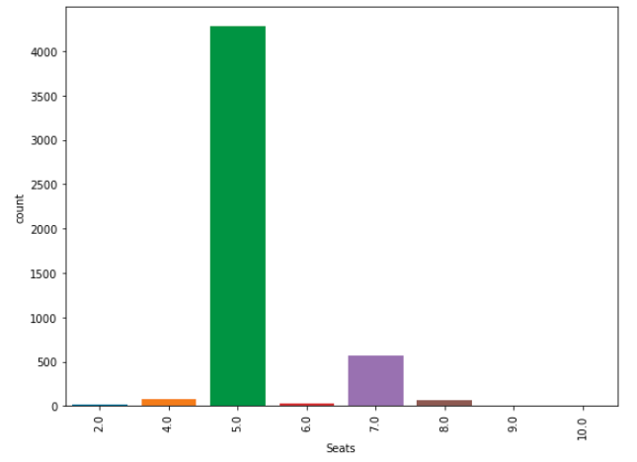
Seating Capacity
Most of cars in my dataset having 5 seated vehicle.

Slide 12
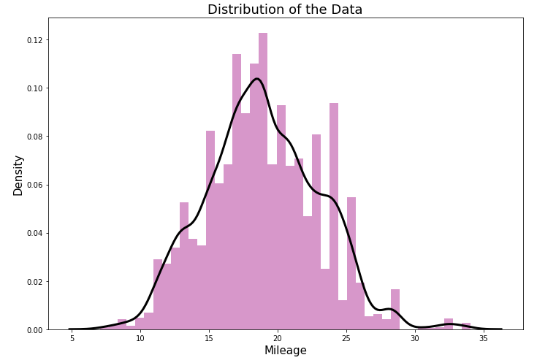
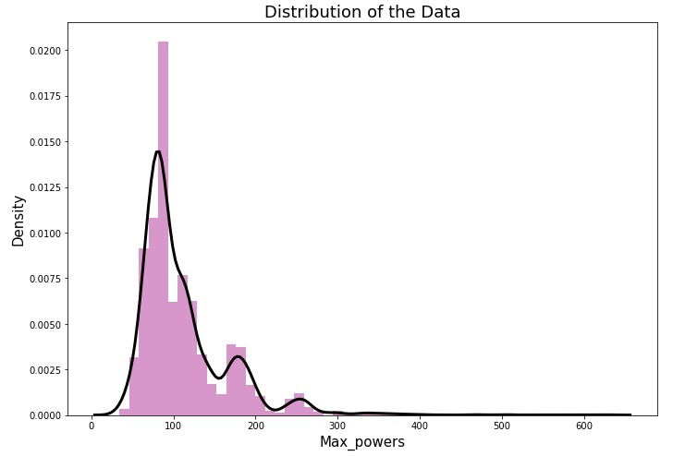
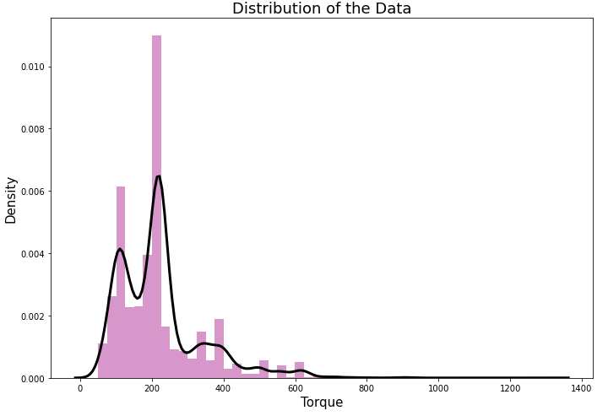
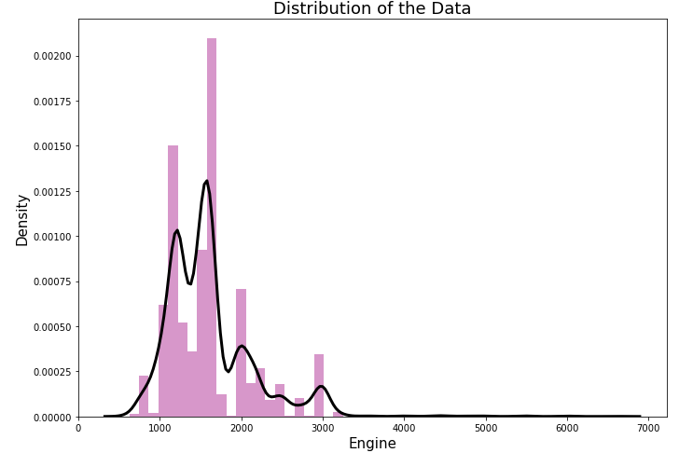
Distribution of continuous data

Slide 13


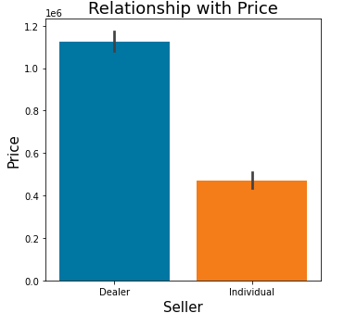
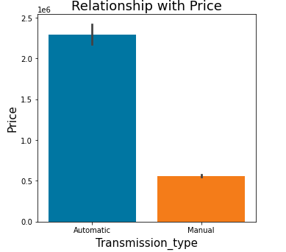
Automatic car's price is high as compare to manual car type. It is always possible because automatic cars having some advanced features, which are not available in manual car that's why Automatic cars are more expensive as compare to Manual type cars.
Dealer cars are more expensive as compare to Individual cars, there could be a reason that In dealer seller cars a dealer include their commission to it's cars price that's why their car's price is higher then Individual cars.

Slide 14


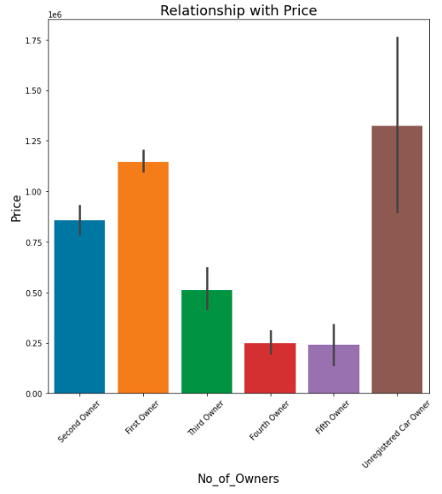
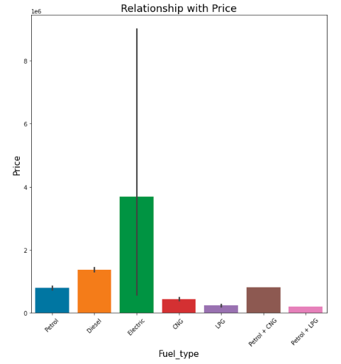
Electric car's price is height with others.
Electric cars are very less in the market right now, they are marked by advanced technology, so it could be reason to get it more costly.
we can see in the above graph that Unregistered car owner type vehicle's price is heights with others. There is could be a reason that unregistered cars are called as fresh cars, they could be Latest model cars or for any reason.

Slide 15

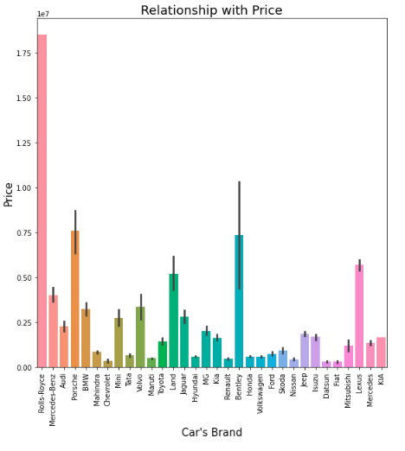
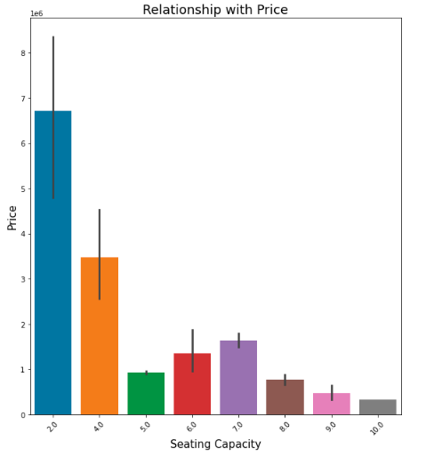

Slide 16
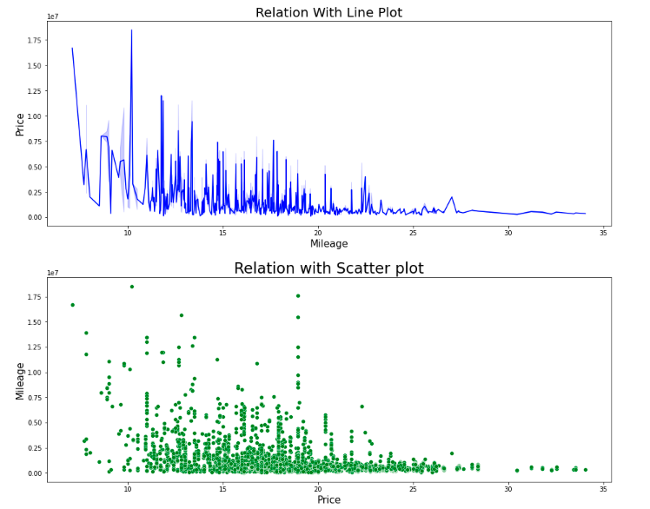
Mileage Vs Price
We can see the clear Negative relation between Mileage and Price.
As Mileage is high the price of the vehicle is low, but as mileage is decreasing, the price of the car is also increasing.
It is obvious that expensive cars have heavy engine that's why their mileage is getting down.

Slide 17
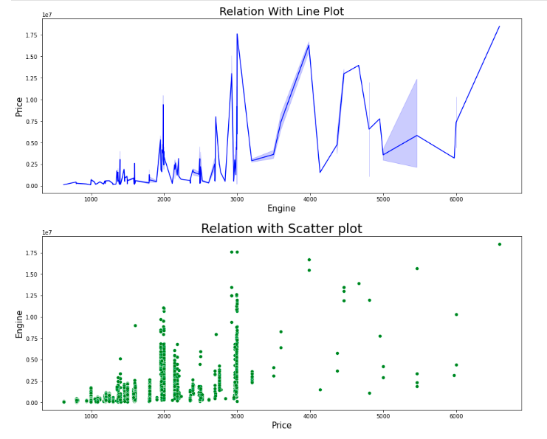
Engine Vs Price
Sharp Innovation
Sharp Innovation

Slide 18
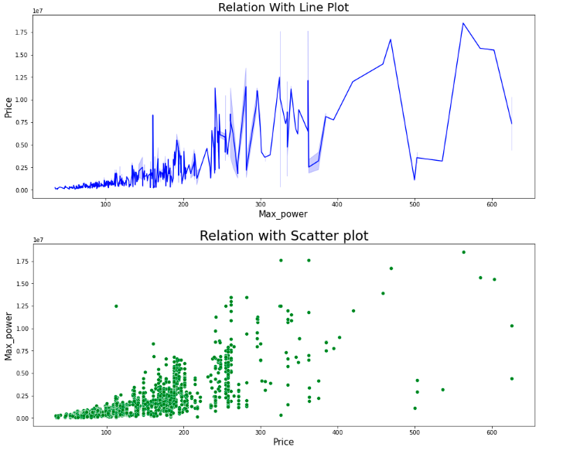
Max_Power Vs Price
abnormal fluctuations

Slide 19
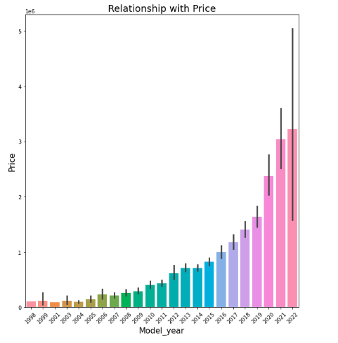
Model Year Vs Price
We observe that as time getting modern the number of new inventions are going high. That's their price is also going high.

Slide 20
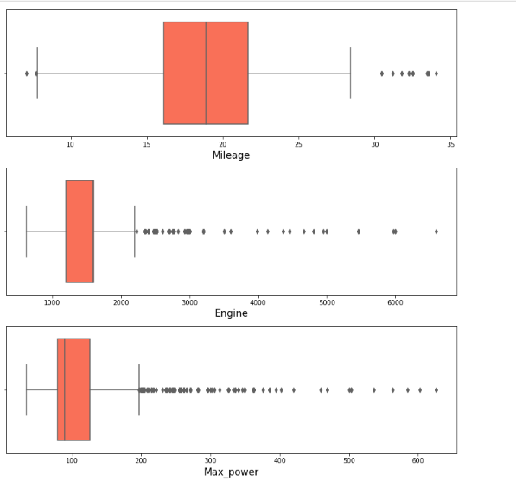

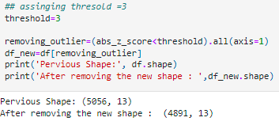
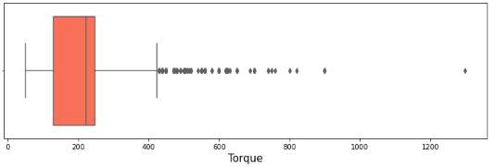
Outliers Detection
Lots of Outliers

Slide 21
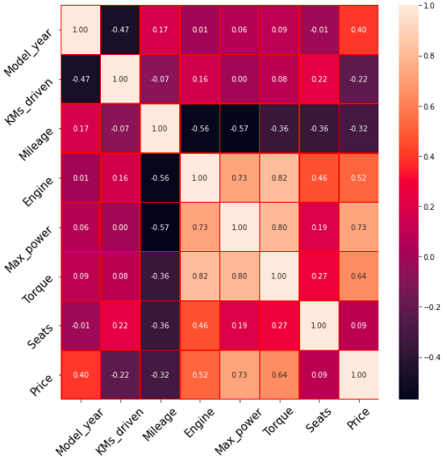
Heat Map
Negatively related with target
Multi-collinearity Problem

Slide 22
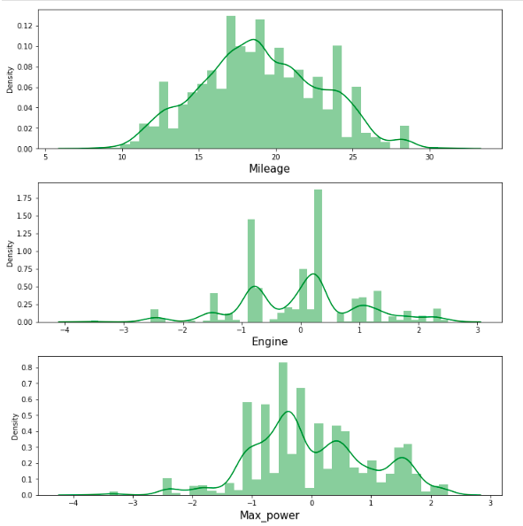
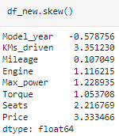
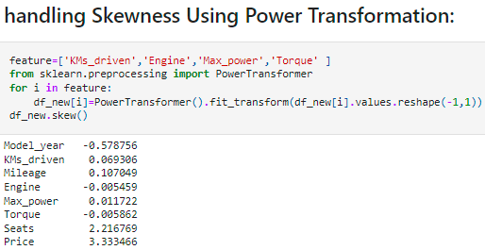
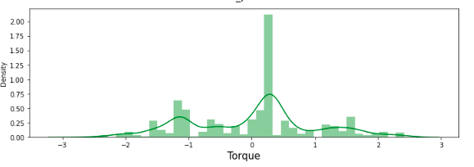
Checking Skewness
Distribution After Transformation
Well Distributed now

Slide 23
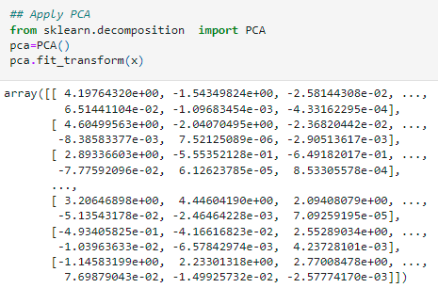
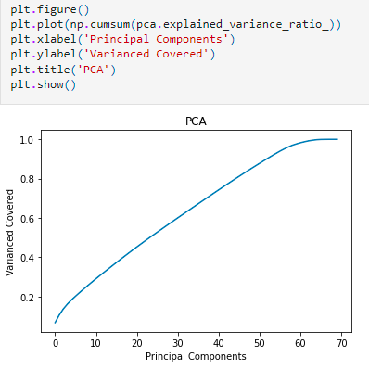
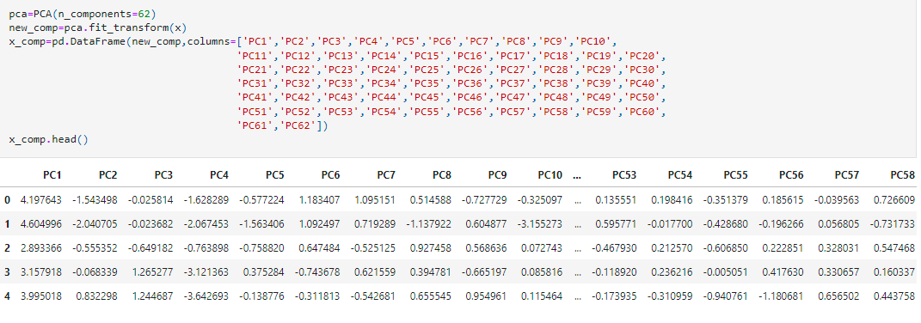
Handling Multi-collinearity using PCA
Step: 1
Step 2
Step: 3

Slide 24
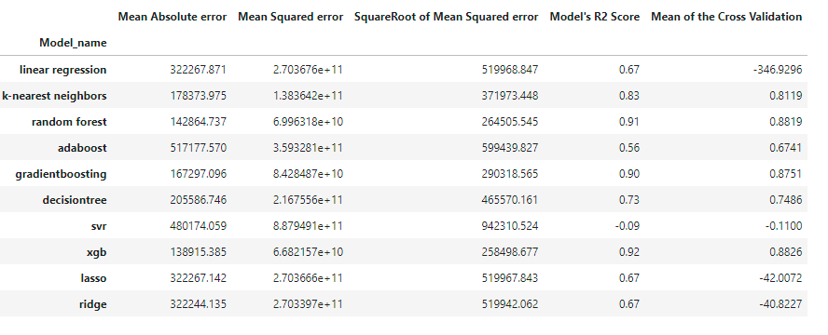
Printing the All Model’s Scores And Compare
Conclusion
: As we Can see that Random Forest Regressor and XGB Regressor performing Very well.

Slide 25
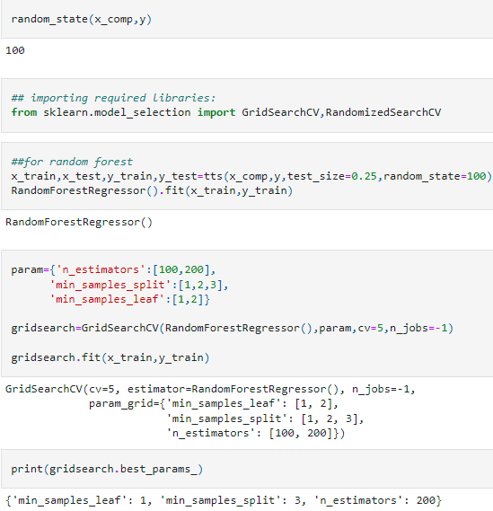
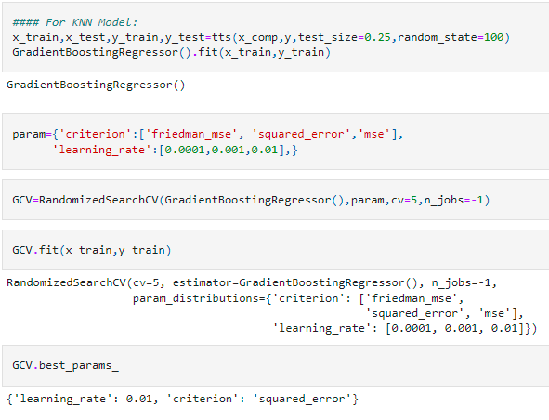

Slide 26
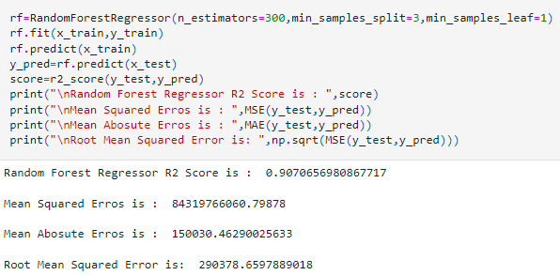

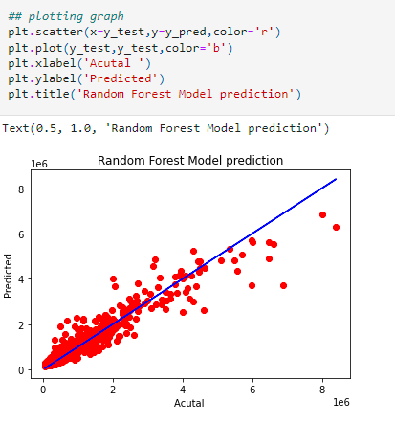
Random Forest Model Evaluation

Slide 27
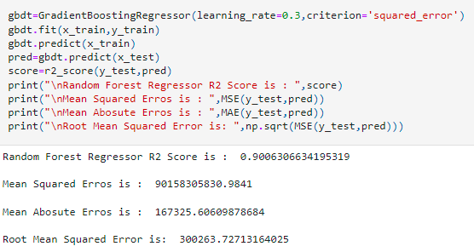
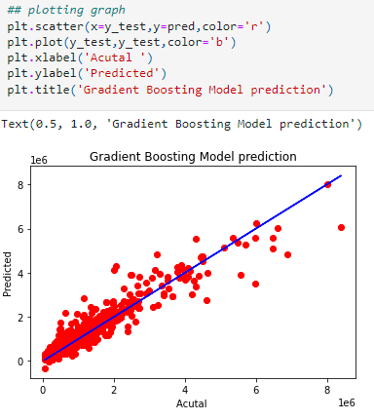
XG Boost Model Evaluation

Slide 28
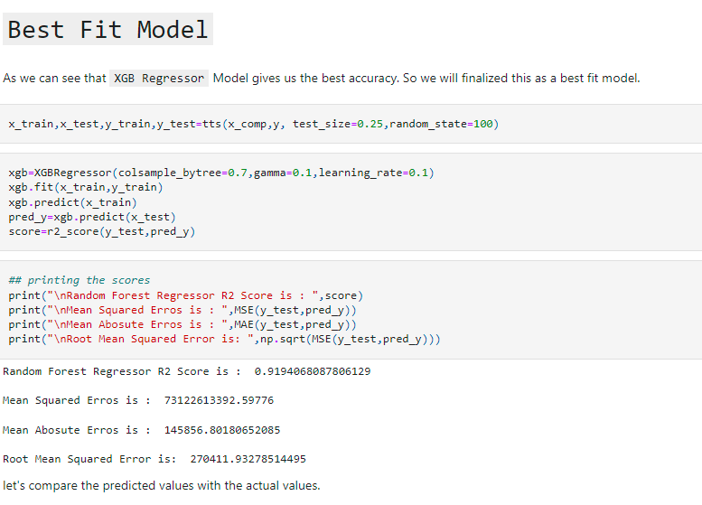

Slide 29
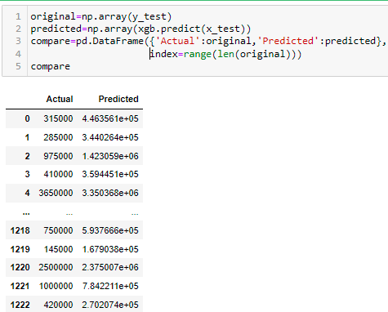
Actual Vs Predicted
XG Boost with 92% Accuracy.

Slide 30
Conclusion
Car price prediction can be a challenging task due to the high number of attributes that should be considered for the accurate prediction. The major step in the prediction process is collection and preprocessing of the data. In this research and project presentation we were built to normalize, standardize and clean data to avoid unnecessary noise for machine learning algorithms.
The increased prices of new cars and the financial incapability of the customers to buy them, Used Car sales are on a global increase. Therefore, there is an urgent need for a Used Car Price Prediction system which effectively determines the worthiness of the car using a variety of features. The proposed system will help to determine the accurate price of used car price prediction. This project I compare many different algorithms for machine learning , But only Random Forest Regression , Gradient Boosting regression and XGBoost Regressor come with very good accuracy.

Slide 31
Future Work And Scope
In future this machine learning model may bind with various website which can provide real time data for price prediction. Also we may add large historical data of car price which can help to improve accuracy of the machine learning model.
We can build an android app as user interface for interacting with user. For better performance, we plan to judiciously design deep learning network structures, use adaptive learning rates and train on clusters of data rather than the whole dataset.

Slide 32


